Slide 1
Premium House Lights:
The Heist
How customer data was stolen
Violet Figueroa
Notes:
Good morning/afternoon. Today, I’ll walk you through “The Heist”—how attackers stole our customers’ data, what it means for Premium House Lights, and how we can prevent it from happening again.

Slide 2
Data Exfiltration Is
The Heist
“Data exfiltration is the unauthorized transfer or theft of sensitive company data from within the network to an external destination”
(StrongDM, 2024; Fortinet, 2025).
The Heist of personal data leading to
financial loss, regulatory penalties, and reputational harm.
Notes:
Data exfiltration is the unauthorized transfer or theft of sensitive company data from within the network to an external destination (StrongDM, 2024; Fortinet, 2025).
Think of it as The Heist. the attackers didn’t just break in—they got away with the goods.

Slide 3


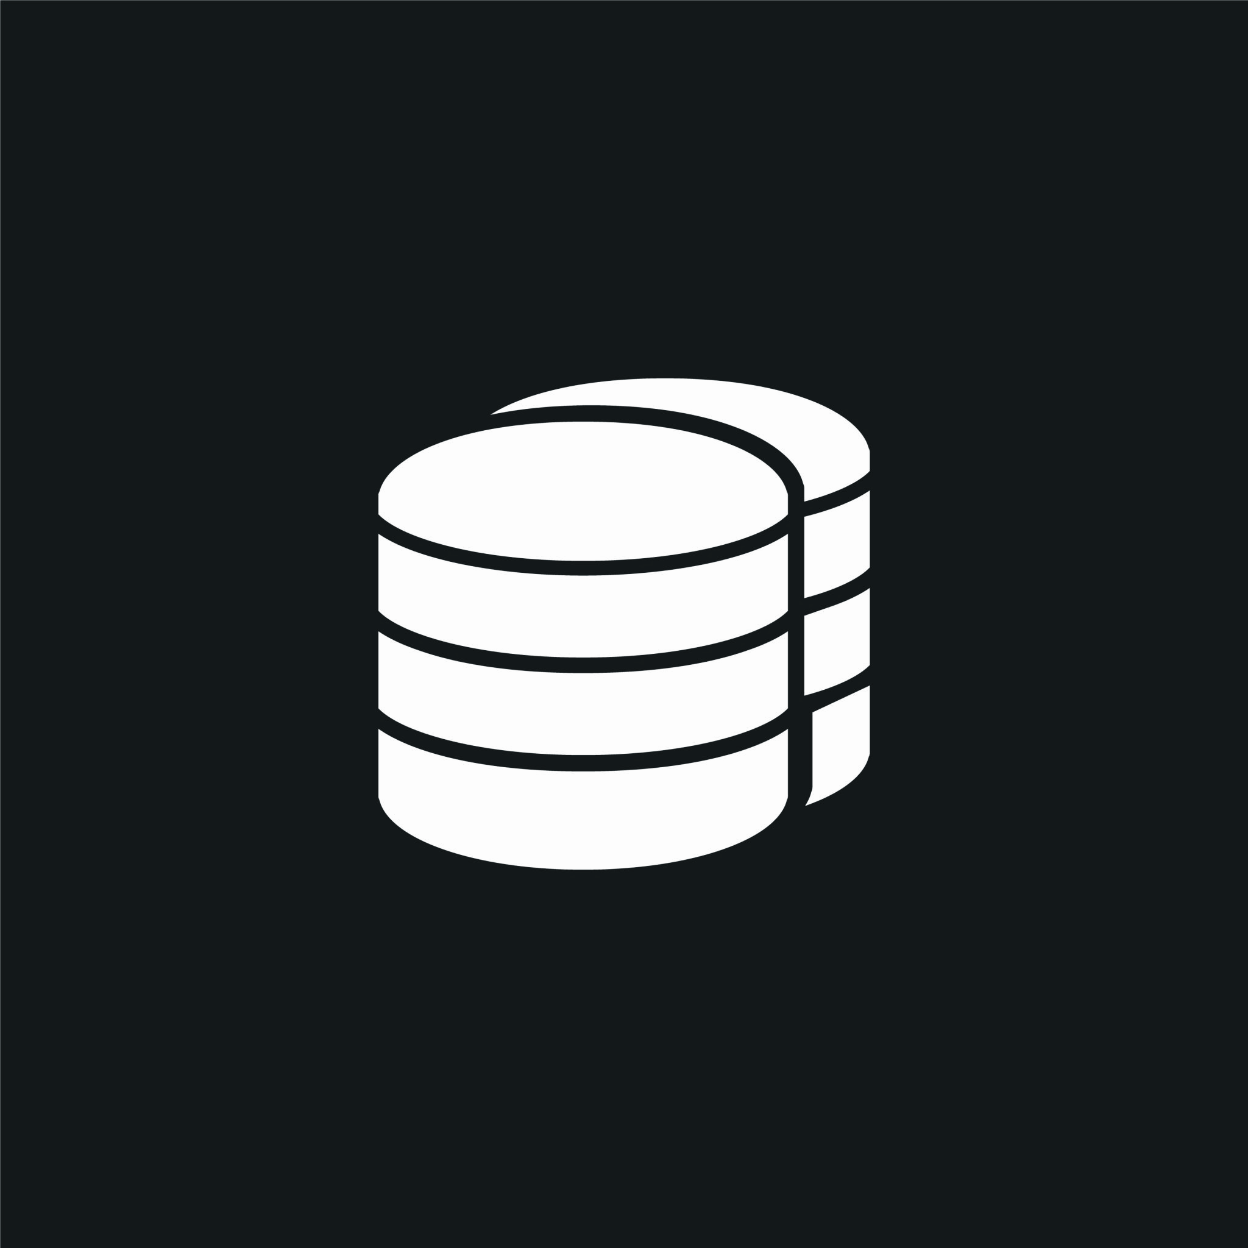


The Plan
Attacker sends exploit to gain access to the public webserver.
Gains remote access, moves to the internal database server.
Gained access to the customer data.
Receives copy of customer data to his server
Sends extortion demand for 10 BTC (~$370,753 USD).
1
2
3
4
5
Notes:
Here’s how the heist unfolded :
The attacker targeted our public webserver, which was directly exposed to the internet.
There were no internal barriers between the webserver and our database.
Once inside, the attacker’s goal was clear: find and steal our customer data.

Slide 4

The Takeaways Of The Heist
244 customer records stolen: Names, addresses, financial data
Ransom demand: 10 BTC (~$370,753 USD)
Consequences:
  Regulatory exposure (GDPR, PCI DSS)
  Customer trust and reputational damage
  Potential business disruption
Notes:
244 customer records stolen: Names, addresses, and financial data
Ransom demand: 10 BTC, worth about $370,753 at the time (StatMuse, 2022)
Consequences:
Regulatory exposure (GDPR, PCI DSS)
Loss of customer trust and reputational damage
Potential business disruption

Slide 5
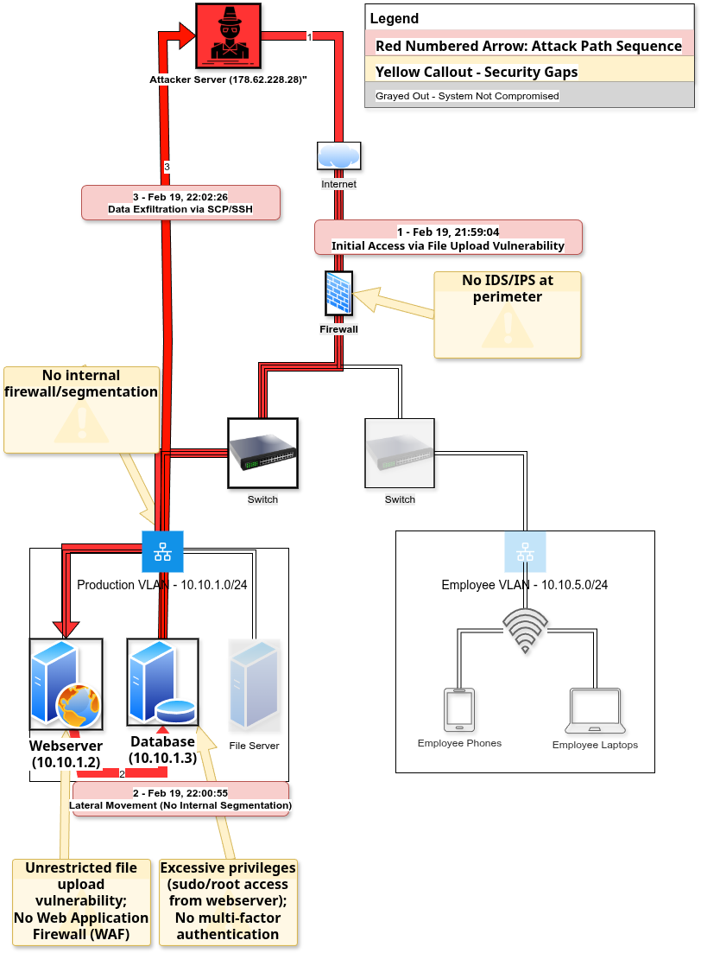
How The Heist Happened
1 Initial Access (Get In)
Unrestricted file upload vulnerability on public webserver (10.10.1.2)
2.1 Lateral Movement (Find The Goods)
No internal segmentation allowed direct access to database (10.10.1.3)
2.2 Privilege Escalation (Say You’re The Boss)
Excessive sudo privileges enabled complete database access
3. Data Exfiltration (Take The Goods)
244 records extracted via SCP to external attacker server
Notes:
1. Initial Access (Get In):
The attacker exploited an unrestricted file upload vulnerability on our public webserver (10.10.1.2). Like picking the lock on the front door, this let them run code on our systems.
2. Lateral Movement (Find The Goods):
With no internal segmentation, the attacker moved straight from the webserver to our database server (10.10.1.3)—no alarms, no locked doors.
3. Privilege Escalation (Say You’re The Boss):
Thanks to excessive privileges, the attacker could access the database as an administrator.
4. Data Exfiltration (Take The Goods):
Finally, they dumped the customer database and used SCP to exfiltrate 244 sensitive records to their own server.

Slide 6

How Do We Secure The Vault?
To stop the next heist, we need to:
  Segment our network with internal firewalls—so attackers can’t move freely
  Deploy a Web Application Firewall (WAF) to block malicious uploads
  Enforce least privilege—no more “all access” passes
  Monitor and alert with IDS/IPS and SIEM
  Consider Data Loss Prevention (DLP) solutions
Proactive controls and monitoring are essential to prevent future thieves.
Notes:
To stop the next heist, we need to:
Segment our network with internal firewalls—so attackers can’t move freely
Deploy a Web Application Firewall (WAF) to block malicious uploads
Enforce least privilege—no more “all access” passes
Monitor and alert with IDS/IPS and SIEM
Consider Data Loss Prevention (DLP) solutions
Proactive controls and monitoring are essential to prevent future thieves

Slide 7
Key Takeaways
Data exfiltration is the most damaging phase of a breach.
Fast detection and strong controls are critical.
Premium House Lights must act now to protect customer data and business reputation.
Notes:
Data exfiltration is the most damaging phase of a breach.
Fast detection and strong controls are critical.
Premium House Lights must act now to protect customer data and business reputation.
Thank you team. I’m happy to answer any and all questions.

